Slide 1

Financial Exclusion and Poverty
Historic Trends in Cities
Monday, 19 November 2018
Leeds Civic Hall
If tweeting please use #LeedsFI

Slide 2
Chair
James Rogers
Director
Communities and Environment
Leeds City Council

Slide 3
Councillor Sharon Hamilton
Support Executive Member
Housing Management
Leeds City Council

Slide 4
Dave Roberts
Financial Inclusion Manager
Leeds City Council

Slide 5

Financial Inclusion in Leeds
Historic Context

Slide 6

Financial Inclusion in Leeds
In the Beginning
Work commenced 2003
Commissioned research – University of Salford
Study completed late 2004
Dissemination conference early 2005

Slide 7
Key Findings
Within Leeds most deprived communities
Cash based economy
Lower utilisation of bank accounts
Higher dependency on doorstep lending
Serious debt problems

Slide 8
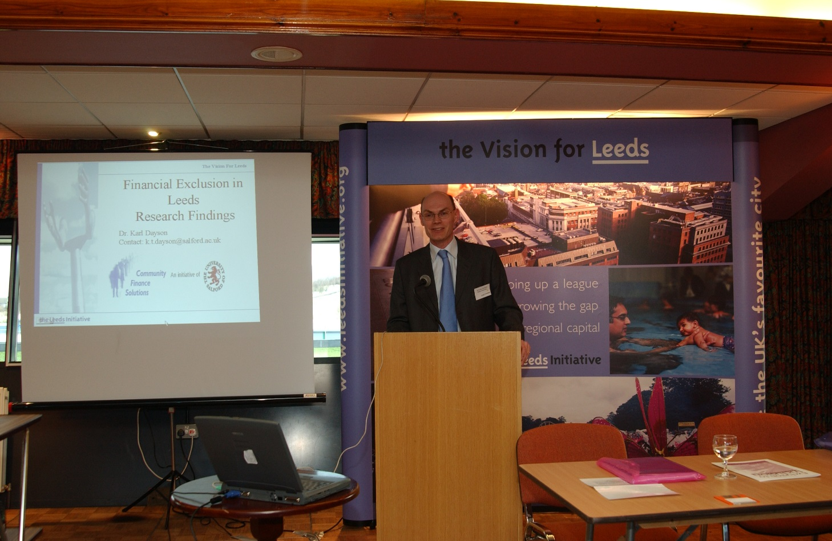
University of Salford
Key Partner

Slide 9
Subsequent Studies
Economic Impact and Regeneration
in City Economies – University of Salford – 2009
Improving Public Health through income maximisation – Leeds City Council – 2011

Slide 10
Subsequent Studies
Evolution of Financial Inclusion
in Leeds since 2004 – University of Salford – 2010
Problem Gambling in Leeds – Leeds Beckett
University – 2016
Financial Exclusion and Poverty – University
of Salford - 2018

Slide 11
Professor Karl Dayson and Dr Pål Vik
Community Finance Solutions
University of Salford
Helen Hardcastle and Miles Crosby
Qa Research

Slide 12



Research into financial inclusion in Leeds – Presentation of findings
Dr Pål Vik and Prof Karl Dayson
Community Finance Solutions, University of Salford
Helen Hardcastle and Miles Crosby
Qa Research
19 November 2018, Leeds Civic Hall, Leeds

Slide 13

Overview of study
Objectives of study:
  Determine evolution of financial exclusion and poverty in Leeds since 2004 and 2010 surveys
  Analyse effectiveness of financial inclusion services and interventions by Leeds CC and partners
 | 2004 survey | 2010 survey | 2018 survey
Deprived areas | 410 | 602 | 602
Economically average |  | 300 | 320

Slide 14
Sampling – deprived sample
The sample for the research designed to:
  Replicate as far as possible the areas chosen in 2010.
  Be representative in terms of the population of these areas at the 2011 Census.
  Survey areas:
  Beeston Hill
  Belle Isle
  Gipton
  Halton Moor
  Harehills
  Holbeck
  Lincoln Green
  Little London
  Richmond Hill
  Seacroft
  South Farm Road
  Profile of sample: Unweighted Weighted
  TOTAL 602 602
  Age 18-34 36% 42%
  Age 35-54 37% 35%
  Age 55+ 27% 23%
  Males 45% 48%
  Females 55% 52%
  White 68% 66%
  BME 32% 34%
  In employment 41% 51%
  Unemployed 10% 12%
  Econ. Inactive 49% 42%

Slide 15
Sampling – economically average sample
The sample for the research designed to:
  Replicate as far as possible the areas chosen in 2010.
  Be representative in terms of the population of these areas at the 2011 Census.
  Survey areas:
  Oakwood /Gipton Wood
  Upper Armley
  Rothwell
  Yeadon
  Profile of sample: Unweighted Weighted
  TOTAL 320 320
  Age 18-34 24% 29%
  Age 35-54 33% 35%
  Age 55+ 43% 36%
  Males 45% 48%
  Females 55% 52%
  White 90% 87%
  BME 10% 13%
  In employment 51% 59%
  Unemployed 04% 05%
  Econ. Inactive 46% 36%

Slide 16
Sampling – weighting
To correct for minor variance between the target sample and the profile of the achieved sample, the deprived sample data was for the 2018 survey was:
  Weighted to 2011 Census profile based on age and employment
  Weighted to the to the tenure profile of the 2004 survey
  The economically average sample was;
  Weighted to 2011 Census profile based on gender, age, ethnicity, and employment
Data weighting ensures that the profile of the sample matches the demographic profile of the subject areas, and also that data is comparable over time

Slide 17
Sampling – significance
All data presented here has been tested for statistical significance.
Data has a natural degree of variance or ‘randomness’ – if the difference between two figures (e.g. 50% and 45%) is statistically significant then it means the difference between them is greater than the random variance and there is a measurable difference
The degree of random variance is called the standard error. For this deprived sample this was +/-3.96%*. A standard error of less than +/-5.0% is said to be statistically robust – this means the findings from the sample can be said to reflect the findings for the whole population had everyone been surveyed.
* At 95% confidence interval

Slide 18
Changing context for survey
2004: The boom years
  Extended period economic growth; plethora financial inclusion initiatives; build-up of debt in lead up to financial crisis
2010: Eye of the storm
  Aftermath financial crisis & recession; credit crunch; job losses; rising debt & repossessions; high levels unemployment
2018: Economic growth and austerity
  Prolonged period low economic growth; rise precarious work; austerity; welfare reform; periodic growth real incomes; falling unemployment; recovery bank lending

Slide 19
Research findings

Slide 20
Banking exclusion

Slide 21
Banking exclusion – fuel payments

Slide 22
Savings habit

Slide 23
Savings habit

Slide 24
Credit exclusion

Slide 25
Use of credit

Slide 26
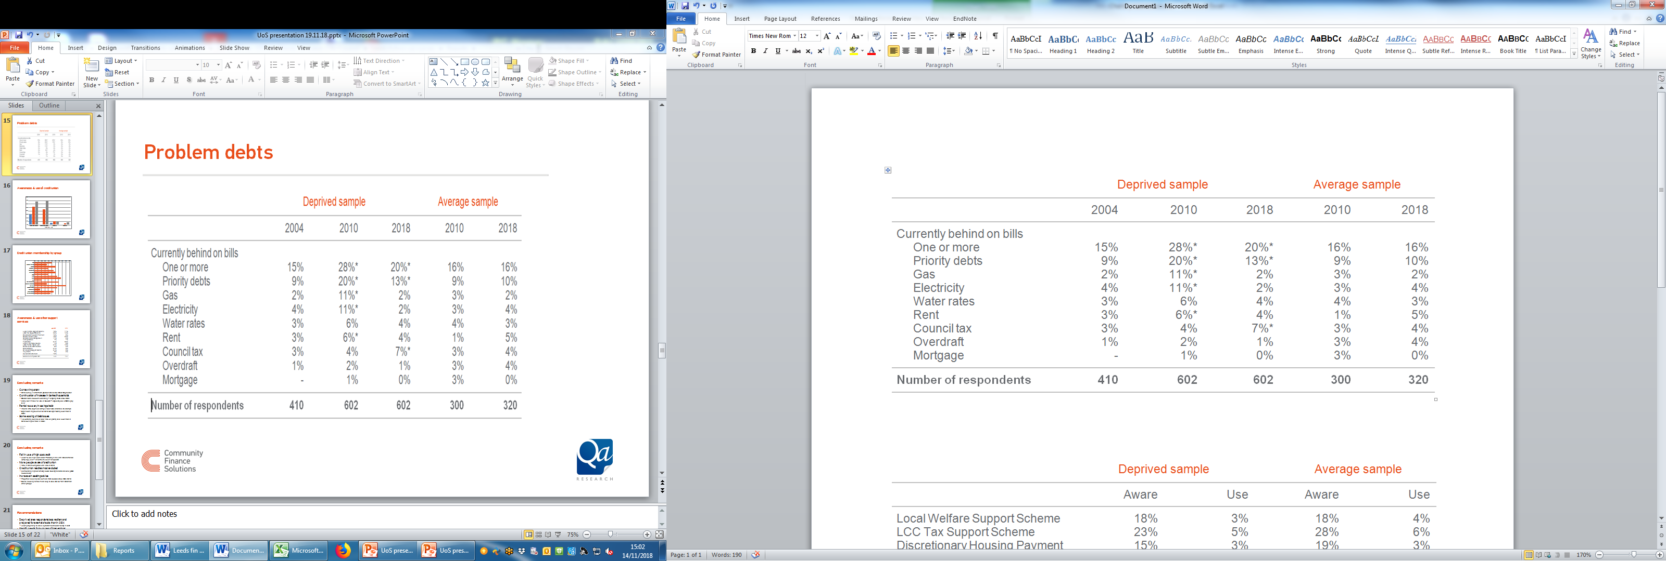
Problem debts

Slide 27
Main determinants financial exclusion
  Tenure: Social housing tenants more likely to lack access to banking services, use high cost credit and be in financial difficulties
Lone parents: Low levels of use of bank services, low levels of savings and a greater propensity to be in debt
Income: People on low incomes and not in work less likely to be banked and to have savings
Age: Younger age groups less likely to save and more likely to have debt problems

Slide 28
Awareness & use of credit union

Slide 29
Credit union membership by group

Slide 30
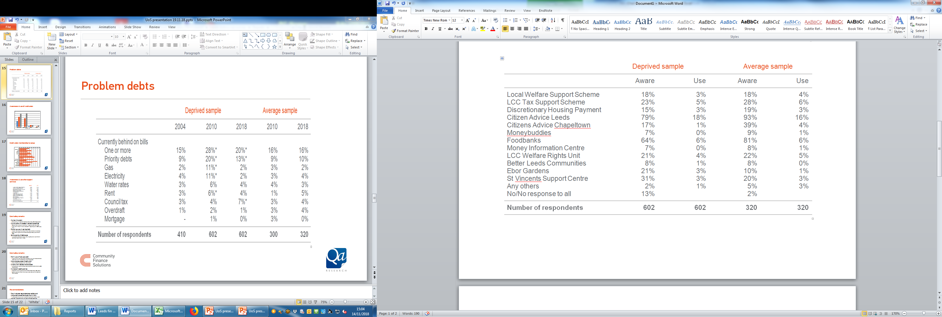
Awareness & use other support services

Slide 31
Use of Citizens Advice Leeds by group

Slide 32
Concluding remarks
Context important
  2010 survey in aftermath greatest crisis since Great Depression
Continuation of increase in banked households
  Greater bank account ownership – ongoing trend since 2004
  Many don’t make full use of account – especially use of DD to pay bills
Partial recovery in savings habit
  Around 40% deprived sample never save and have no savings
  Significant improvement on 2010 but significantly lower than in 2004
Some easing of debt issues
  1/5 currently behind on bills; 13% on priority bills; lower than in 2010 but higher than in 2004

Slide 33
Concluding remarks
Fall in use of high cost credit
  Lower % use high cost credit – broadly in line with national trends; worryingly over 1/3 borrow to cover living costs
More people aware of credit union
  70% in 2018 compared with 45% in 2010
Credit union reaches most excluded
  Membership highest among social housing tenants and lone parent households
Increase in seeking advice
  Proportion seeking advice more than doubled since 2004/2010
  Social housing rented more likely to seek advice from CAB than other groups

Slide 34
Recommendations
Deprived area respondents less resilient and prepared for external shocks than in 2004
  Lower propensity to save & greater likelihood of being in debt
Identify needs for two types of interventions:
Enhance savings habit
  Support new & existing interventions to support households building savings habit
Create surplus to save
  Need to support interventions building capacity to save (e.g. income maximisation, debt remedies, collective purchasing)

Slide 35
Thank you – any questions?
Dr Pål Vik and Prof Karl Dayson
Community Finance Solutions, University of Salford
Helen Hardcastle and Miles Crosby
Qa Research

Slide 36
Chair
Liza Kellett
Chief Executive
Trust Leeds

Slide 37
Rose Doran
Senior Advisor
Local Government Association

Slide 38
Reshaping financial support
Rose Doran
Senior Adviser
Local Government Association
19th November 2018
www.local.gov.uk

Slide 39
Context
Pressures on low income households
Pressures on council budgets – making the case for prevention
Welfare reform and Universal Credit
www.local.gov.uk

Slide 40
Why ‘reshaping financial support’?
Government narrative dominated by ‘employment’ (but not pay, progression or living costs)
Disconnect between welfare policy and housing / homelessness policy (affordability)
Relationship between the citizen and the state (digital by default)
Growth in ‘problem debt’
Why poverty matters to local government

Slide 41
Scoping exercise
Ten councils, including Leeds
Identify good practice that can be built on in some (potential) pathfinders
Direct financial support
Indirect support and advice
Financial relationship and debt recovery
Financial health

Slide 42
Key findings
Councils have been working across service responsibilities and joining up their provision to better meet the needs of lower income households
Councils are improving customer journeys and resolving peoples’ problems earlier
Councils have been reviewing their approach to debt collection
Councils are leading financial inclusion partnerships to provide long term strategic direction to provision, and to support the development of financial services and products for low to middle income households

Slide 43
Pathfinders could…
Pro-actively identify people in financial difficulty and provide them with a more fully integrated offer of support
Trial the co-commissioning of advice provision with the Money Advice Service
Test out and learn from new innovations in advice provision and debt collection
Take advantage of new opportunities to boost investment in not-for-profit lenders and develop closer links between local authority support and these services.

Slide 44
With a hope to…
Aid future decision-making by councils on the costs and benefits of putting preventative approaches in place
Inform the ongoing development of good practice in local authority debt collection
Highlight and strengthen the role of local government (and its local partners) in the welfare system, and in supporting low income households

Slide 45
Contact:
rose.doran@local.gov.uk
07747 636843

Slide 46
Chris Goulden
Deputy Director
Policy and Research
Joseph Rowntree Foundation

Slide 47

Destitution in the UK 2018
Chris Goulden
Deputy Director
Evidence and Impact

Slide 48
Why do it and what did we ask?
Concerns around destitution have intensified since 2015
How much UK destitution is there (in 2017)?
Who is affected by it?
What are the main pathways in?
What should we do about it?

Slide 49
Definition of destitution
People who have lacked two or more of six essentials over the past month because they cannot afford them:
Shelter (slept rough for one or more nights)
Food (fewer than two meals a day for two or more days)
Heating their home (five or more days)
Lighting their home (five or more days)
Clothing and footwear (appropriate for weather)
Basic toiletries
OR
Had an income so low that were unable to purchase these essentials for themselves

Slide 50
Methods
Case studies of destitution in 16 UK locations:
one-week user survey of 103 crisis services – 2,905 returns
41 in-depth interviews
Secondary analysis of over 40 quantitative datasets enabled scaling up to national level

Slide 51
The scale of destitution
1,550,000 people, including 365,000 children, experienced destitution in the UK in 2017
  This means they could not afford the bare essentials that we all need to eat, stay warm and dry, and keep clean
Levels of destitution appear to have declined by around 25% between 2015-2017
  Reductions in benefit sanctions the most significant factor

Slide 52
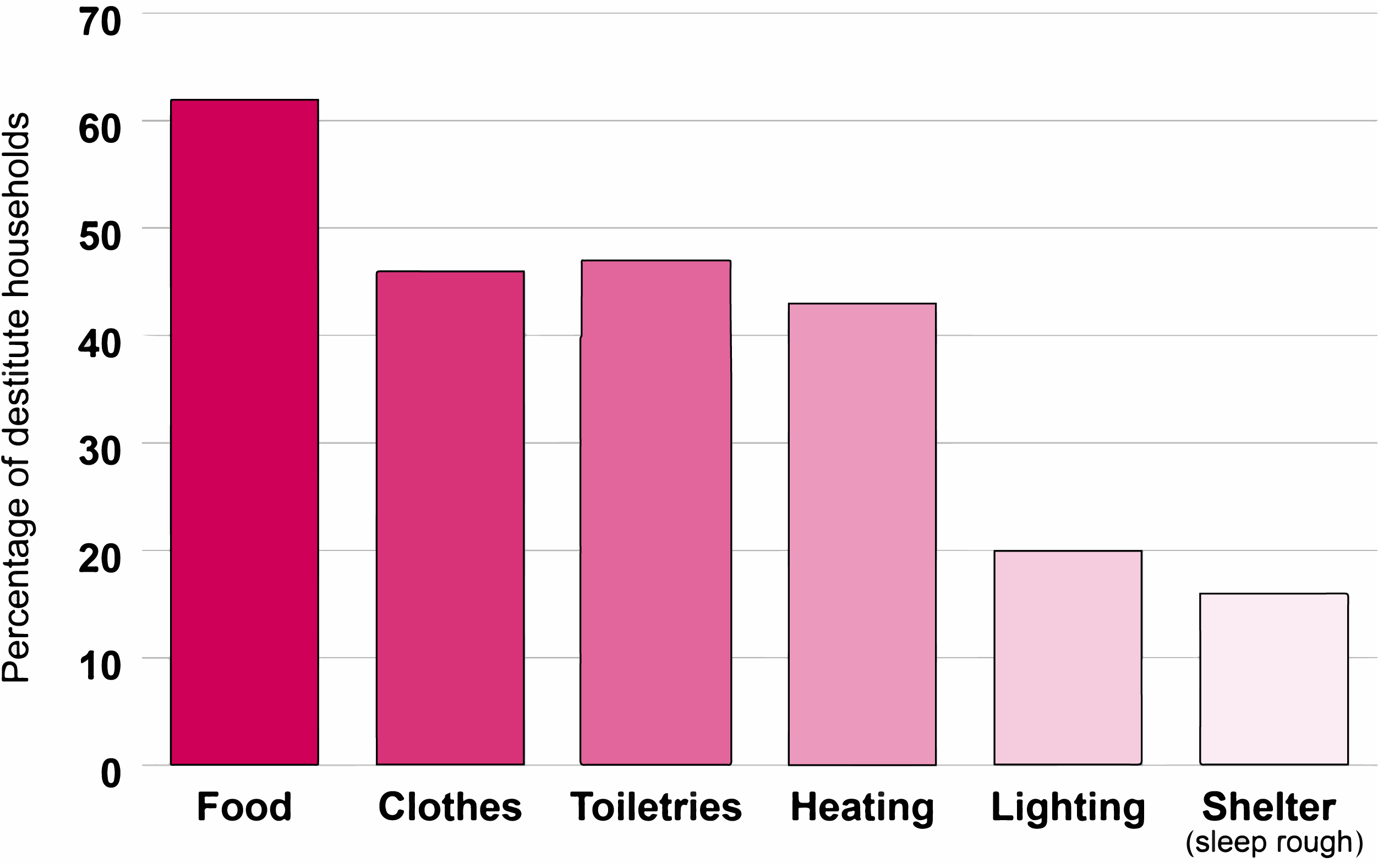
Essentials lacked in the last month

Slide 53
The people affected
Single men under 35 are at highest risk
  extremely rare amongst over 65s
Some migrant groups are at disproportionate risk, but 75% of those destitute were born in UK
Two-thirds of destitute households live in rented accommodation (mainly social housing)
  Remainder in temporary or shared accommodation or sleeping rough

Slide 54
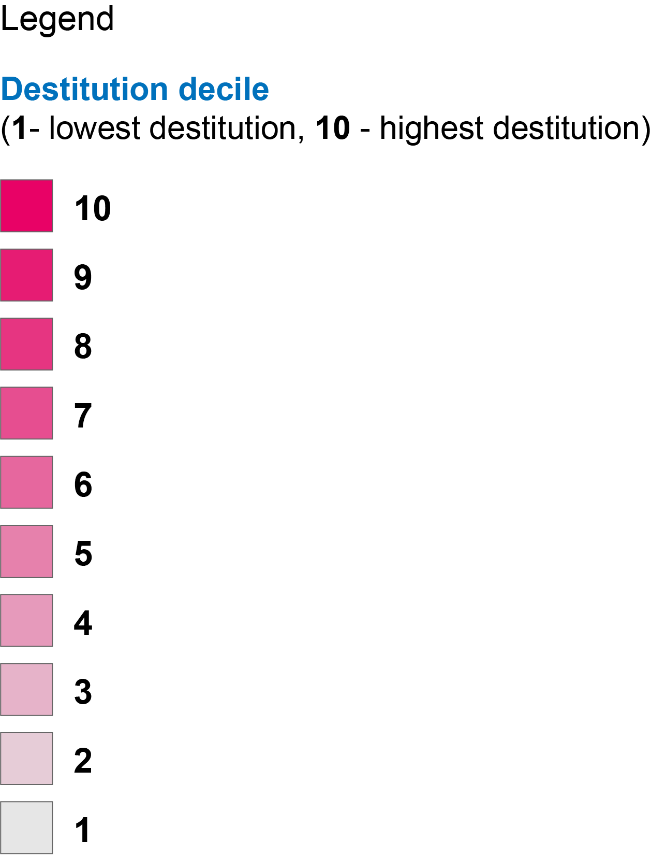
The geography of destitution

Slide 55
Routes into destitution
‘UK-other’ group (68%) – debt recovery practices; benefit issues; disability/ill-health; low/erratic pay
‘Complex needs’ group (15%) – also: relationship breakdown (including DV); drug/ alcohol; offending; eviction
‘Migrants’ (16%) – also: no access to labour market; benefit eligibility/ extremely low levels of benefits

Slide 56

The typical tangle of issues
“Straight away £44 goes out of our benefits to Bedroom Tax and arrears…We moved onto the foodbank a few weeks ago… The reason why we started going was because I'd been really poorly and hospitalised… I had my PIP [Personal Independence Payment] stopped, and…we couldn't afford to live… we're paying this Bedroom Tax… It was just all a nightmare…”

Slide 57

The humiliation
“…it was foodbanks, friends, family. It was pretty much a case of, almost begging, I suppose… Because I'm quite a proud person… I don't necessarily like asking for help, but it was at the stage where we had no choice.”

Slide 58
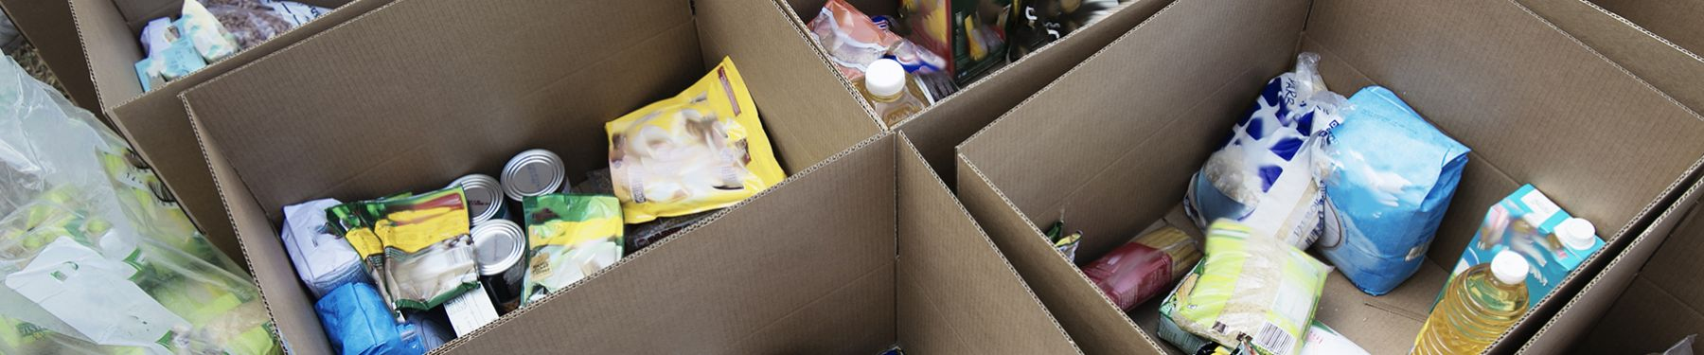
The indignity
“The first time I went to the foodbank they gave me toilet roll, but last time I went they didn't have any… I went to a public toilet and stole some toilet roll to go home.”

Slide 59
Solving destitution
Prevent destitution by design
  Close gaps between costs and benefits
  Reform and reduce sanctions
  End the benefits freeze
Adequate levels of benefits
  Regardless of age or immigration status
Overhaul debt recovery practices
  30% rather than 40% cap in right direction
Funded and fair Local Welfare Assistance
Social landlords playing a leading role

Slide 60
Panel
An opportunity to question the speakers
If tweeting please use #LeedsFI

